Slide 1
Diabetes
Trends and Prevalence
Team #13:
Tejas Sadarahalli
Shashank Solomon
Aiman Jabaren
Treven Moore
Notes:
Good evening everyone, we are here to present the different trends in diabetes

Slide 2

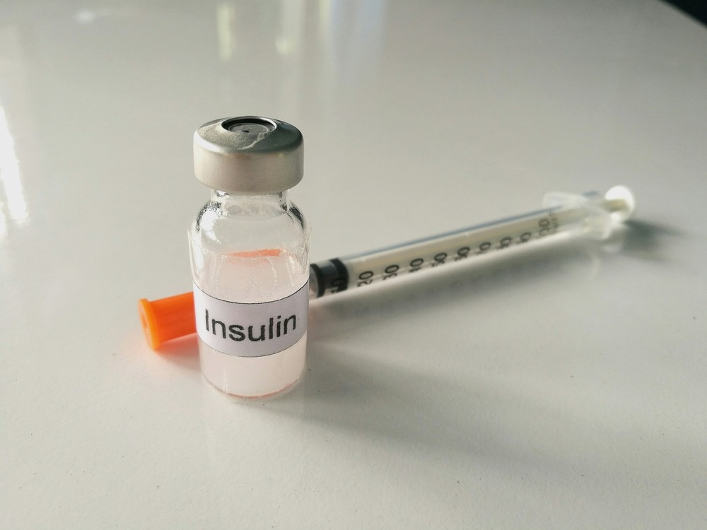
What is diabetes, and why do we care?
Diabetes - high levels of blood sugar
Unable to regulate - low insulin levels
Leads to heart disease, stroke
Has no cure
>3.5 Million deaths in 2017
245 Billion $ spent
Notes:
What is diabetes and why do we care,
Diabetes is characterized by high levels of blood sugar and the inability of the pancreas to regulate insulin levels
It leads to heart diseases and strokes and currently has no cure
In 2017 diabetes resulted in more than 3.5million deaths a year across the world
In the US 245 Billion dollars is spent on diabetes in a year
Maybe we could use a chart that shows both the top causes of death, and then the color/size/etc. of each causes is its correlation with diabetes
Diabetes is due to either the pancreas not producing enough insulin, or the cells of the body not responding properly to the insulin produced
As of 2017, an estimated 425 million people had diabetes worldwide, with type 2 diabetes making up about 90% of the cases.
This represents 8.8% of the adult population, with equal rates in both women and men.
Trend suggests that rates will continue to rise. Diabetes at least doubles a person's risk of early death.
In 2017, diabetes resulted in approximately 3.2 to 5.0 million deaths. The global economic cost of diabetes related health expenditure in 2017 was estimated at US$727 billion. In the United States, diabetes cost nearly US$245 billion in 2012.

Slide 3













Data Overview / Methodology
Notes:
We scrapped health organization such as WHO, CDC and used Python Libraries in order to process the data and we plotted and visualized and the processed data using Holoviews, Plotly, Geopandas and other platforms

Slide 4
Questions to be answered
What is prevalence of diabetes across the world and what is its correlation to being overweight?
What are the most effective metrics to predict high rates of diabetes?
How can changes in lifestyles across geographical regions decrease diabetes in the population?
How does income affect a person’s ability to effectively treat diabetes?
Notes:
We had multiple questions to be answered in the beginning
First - What is the prevalence of diabetes across the globe?
Second - Is it correlated to other factors such as being overweight and different lifestyle choices?
Third - What are the risk factors for diabetes ?
Fourth - Does Income play a role in the discovery and treatment of Diabetes

Slide 5
Global Data
Notes:
To start with we are going investigated global trends in diabetes

Slide 6
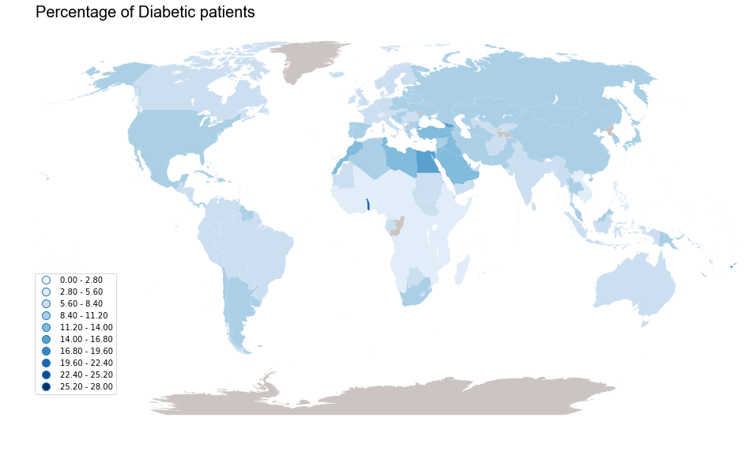
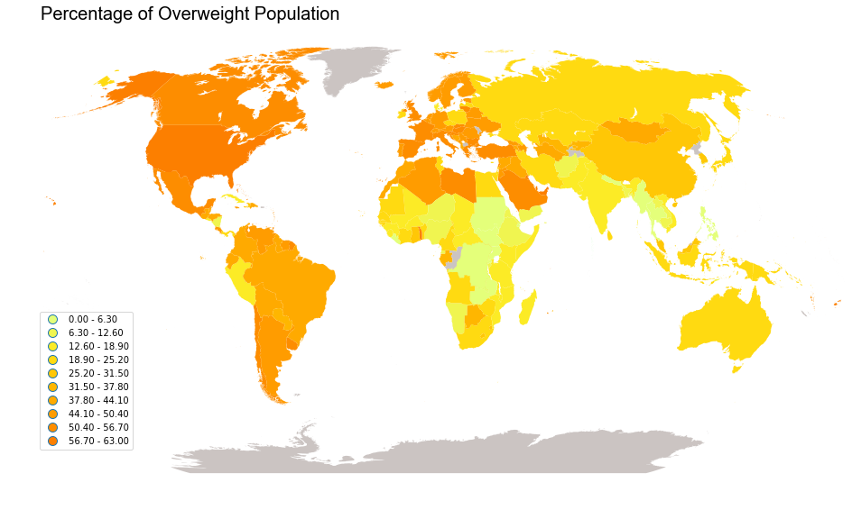
Overweight vs. Diabetes
Notes:
We scrapped statistics from different countries and plotted the prevalence of diabetes around the world in order to look for trends and correlation.
As you can see diabetes is more prevalent in certain countries and this can be due to race, GDP and lifestyle.
In order to investigate more, we have also plotted overweight statistics across the different countries and we can see that the trends in both heat maps are similar.
So we can infer that there is a certain correlation between being overweight and being diabetic.

Slide 7
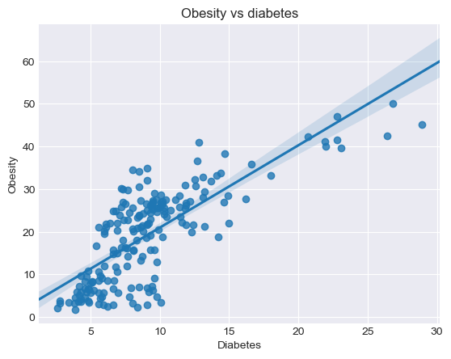
Correlation plot
Notes:
Over here, We plotted the correlation between diabetes and obesity for the different countries and as you can see there is strong correlation between them.
From this plot, we can say that obesity leads to diabetes or visa versa, or they both of them are products of common factors, such as genetics or lifestyle.

Slide 8
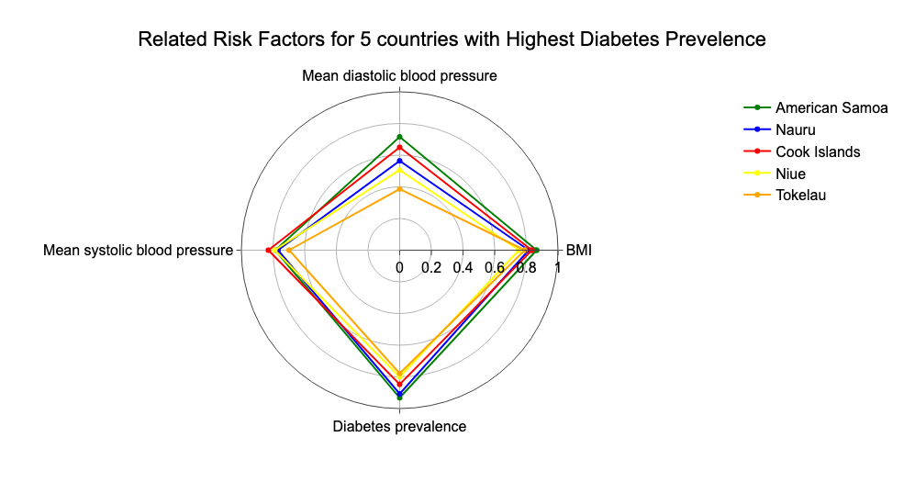
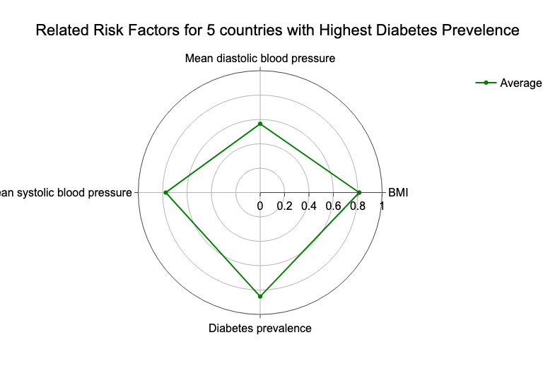
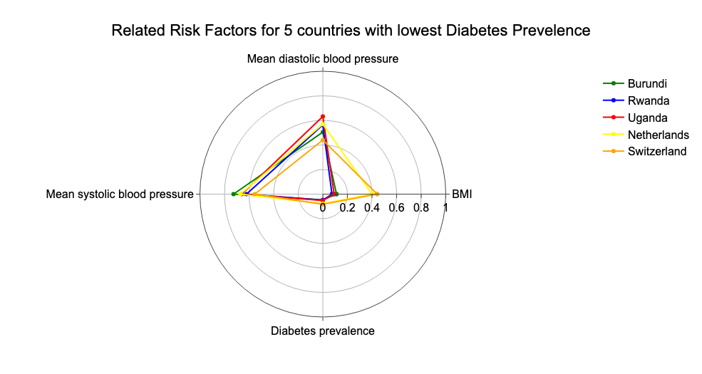
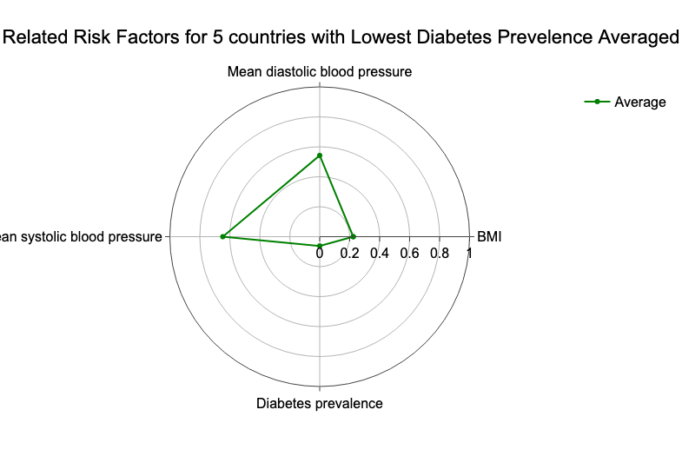
What is a good metric?
Notes:
On the left we plotted the blood pressure and bmi along with the prevalence of diabetes of the 5 countries that have the highest rate of diabetes
on the right we plotted their averages.
As you can see they all share a high BMI with a relatively large spread in Diastolic Blood Pressure
This shows that BMI is a reliable metric to predict a country’s rate of diabetes while Blood pressure is not.
MAKE THIS INTO TWO SLIDES: Each slide:
Left side-> 5 individual countries
Right side-> avg of the 5 countries
These graphs show the blood pressure, BMI, and prevalence for the 5 countries with the lowest (on the left) and highest (on the right) % of population with diabetes. For the countries with the highest diabetes prevalence, we can see that they have a small spread in their systolic blood pressure and all share high BMI. This indicates that these can hold as good metrics to predict the rate of diabetes in a population. In the countries with the lowest prevalence of diabetes, we see a large spread in BMI, which tells us that while a high BMI may indicate high rate of diabetes, the opposite is not necessarily true for low BMI levels.

Slide 9
What is a good metric?
Notes:
On this slide, we plotted the same data, but for the the 5 countries that have the lowest prevalence in diabetes
As you can see, the countries with the highest prevalence and the countries with lowest prevalence share a similar range when it come to blood pressure.
Although on the previous slide the spread in the BMI amongst the countries was small, on this slide you can see that there is a bigger spread in BMI.
This leads us to believe that, the correlation between BMI and Diabetes is stronger when the BMI is higher than average BMI of the countries.
MAKE THIS INTO TWO SLIDES: Each slide:
Left side-> 5 individual countries
Right side-> avg of the 5 countries
These graphs show the blood pressure, BMI, and prevalence for the 5 countries with the lowest (on the left) and highest (on the right) % of population with diabetes. For the countries with the highest diabetes prevalence, we can see that they have a small spread in their systolic blood pressure and all share high BMI. This indicates that these can hold as good metrics to predict the rate of diabetes in a population. In the countries with the lowest prevalence of diabetes, we see a large spread in BMI, which tells us that while a high BMI may indicate high rate of diabetes, the opposite is not necessarily true for low BMI levels.

Slide 10
United States Data
Notes:
Now let's look at data pertaining to the United States

Slide 11
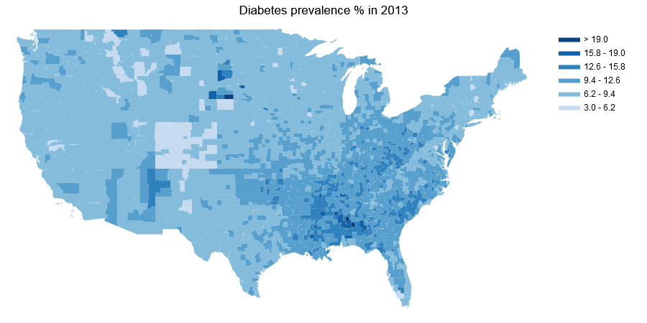
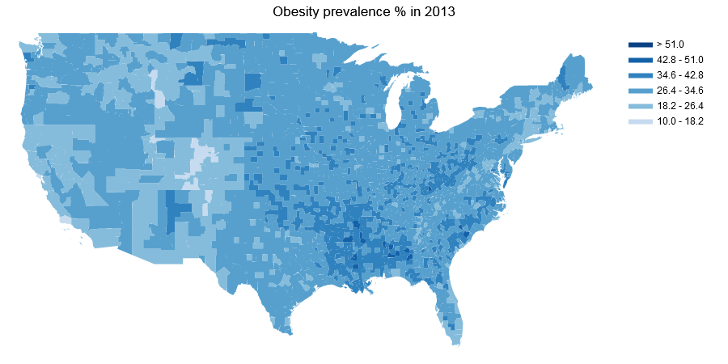
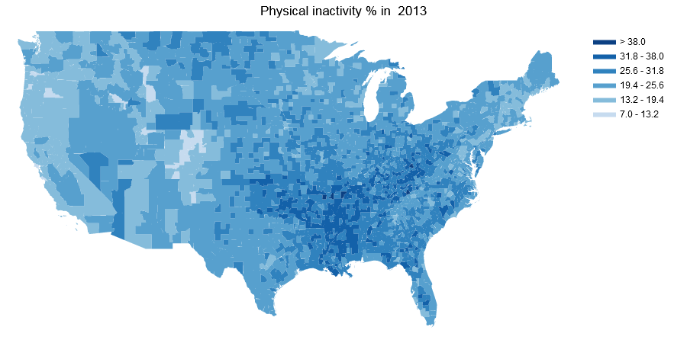
How does lifestyle affect diabetes?
Notes:
On this slide we have plotted county wise data, for diabetes prevalence on the top, obesity prevalence on the bottom left and physical inactivity on the bottom right.
Focusing on the south east area on all three maps, there seems to be higher prevalence of diabetes, obesity and physical inactivity in this region
Although blood pressure and BMI can be useful metrics to predict diabetes, we also see that lower physical activity, obesity, and diabetes are all related. This is important when trying to find ways to reduce diabetes in a region; for example, cities could start programs designed to increase the physical activity of adults living there.

Slide 12
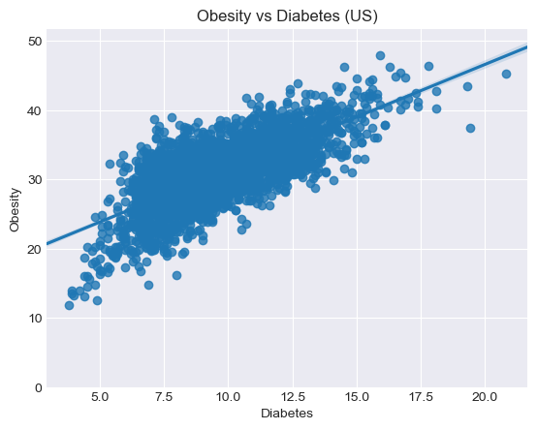
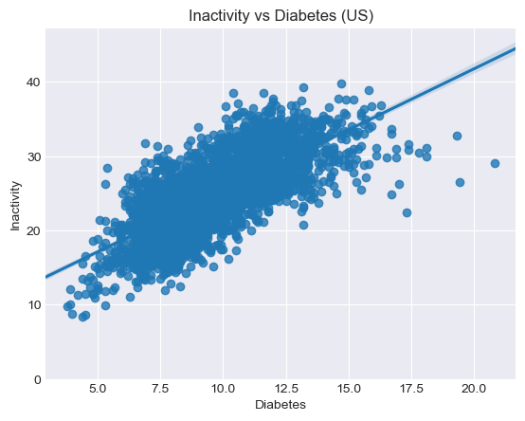
Correlation plots
Notes:
On the next slide we plotted the correlation between Obesity and Diabetes and Inactivity and Diabetes.
Both plots seem to show strong positive correlation. This data also reinforces the conclusion from the global data.
Leading us to conclude that obesity and inactivity are major risk for diabetes,both being influenced by lifestyle.

Slide 13
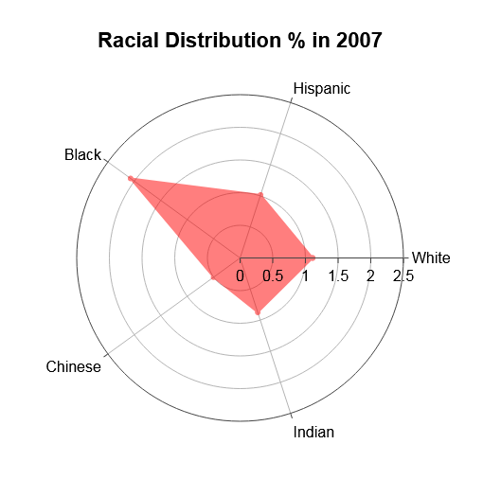
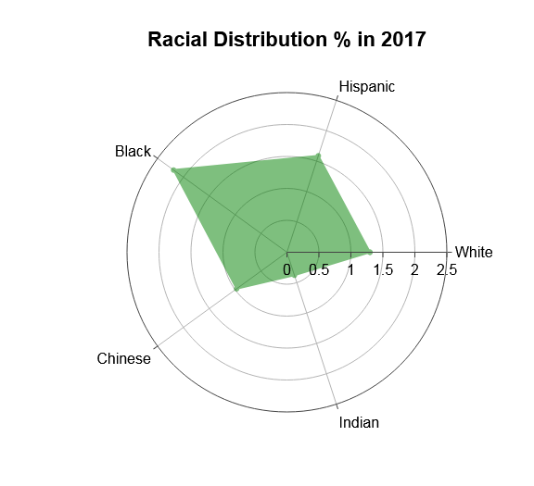
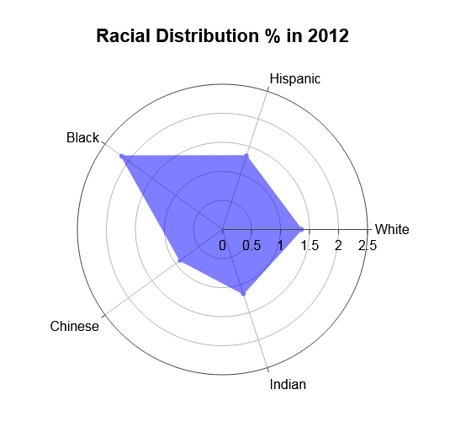
What percent of each race in the US is diabetic?
Notes:
Let’s look at race data across the United states, So we plotted the percentage of diabetic patients in each race over three years 2007, 2012 and 2017.
We see that the people of african american origin, show higher percentages of diabetes followed by hispanics

Slide 14
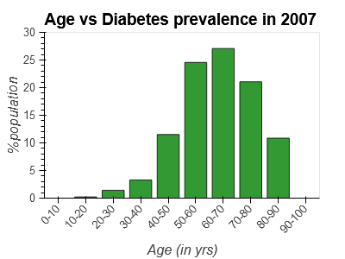
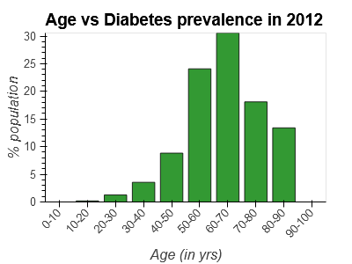
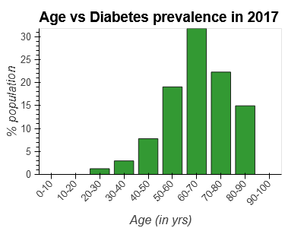
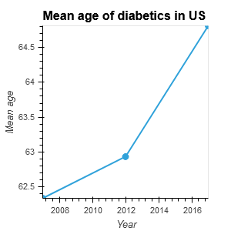
We got healthier!
Notes:
So let’s look at ages wise distribution of diabetes in the United States.
We see expected trends in all three years, where people around the 60-70 years old show higher prevalence of diabetes.
So the mean age trend gives us some interesting conclusions.
Between 2007 and 2012, the mean age increased by about a year, which indicates that more people below the mean age developed diabetes.
The increase is more aggressive between 2012-2017, which means less people under the mean age developed diabetes.
So we conclude that the population within the United states got healthier! This maybe because of increase in social and medical awareness
As you can see from the bottom-right graph, the mean age of people diagnosed with diabetes has been increasing for over a decade. This indicates that people are getting diabetes later in life, which we can reasonably say shows that diabetes prevention is getting better. This is supported by the 3 graphs showing the ages of diabetic patients in 2007, 2012, and 2017.

Slide 15
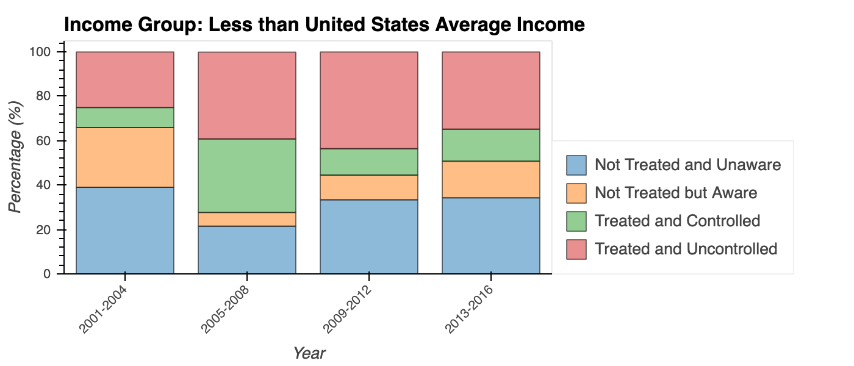
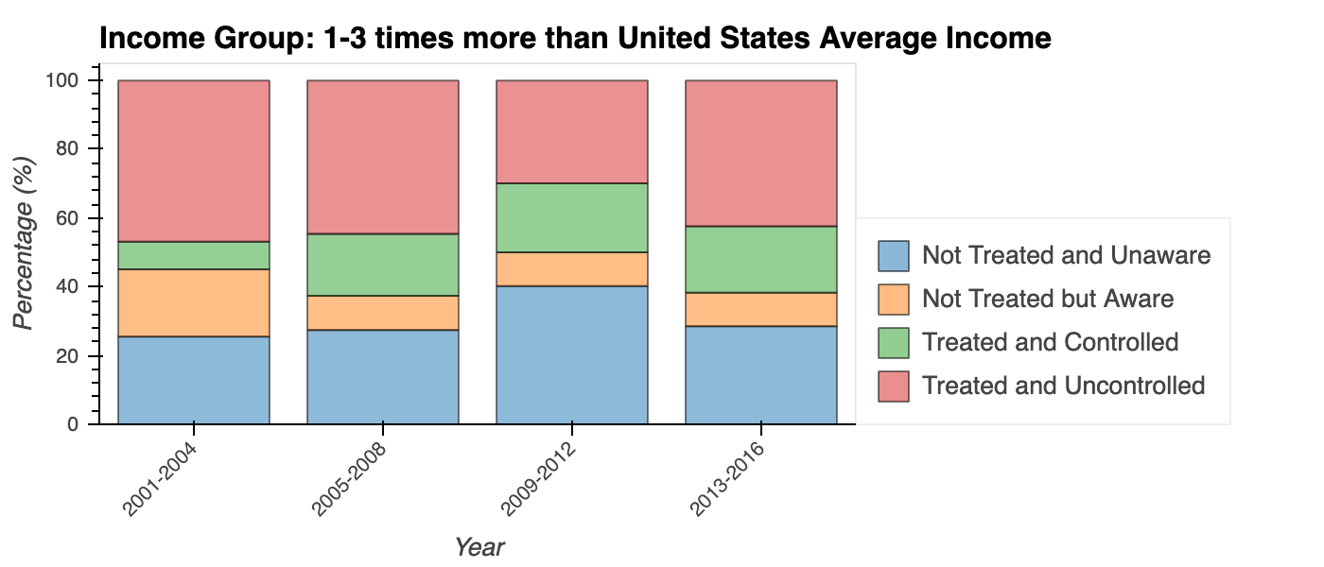
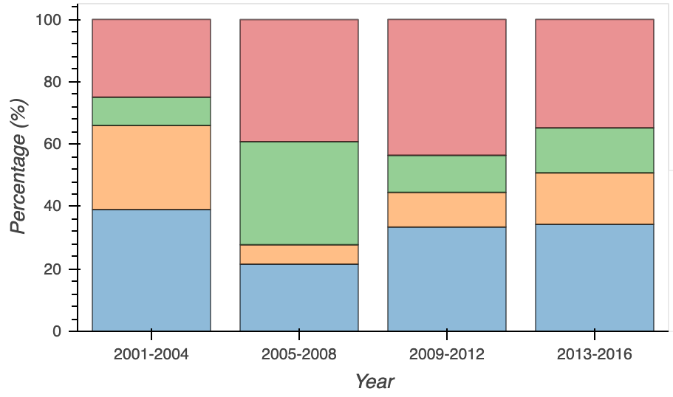
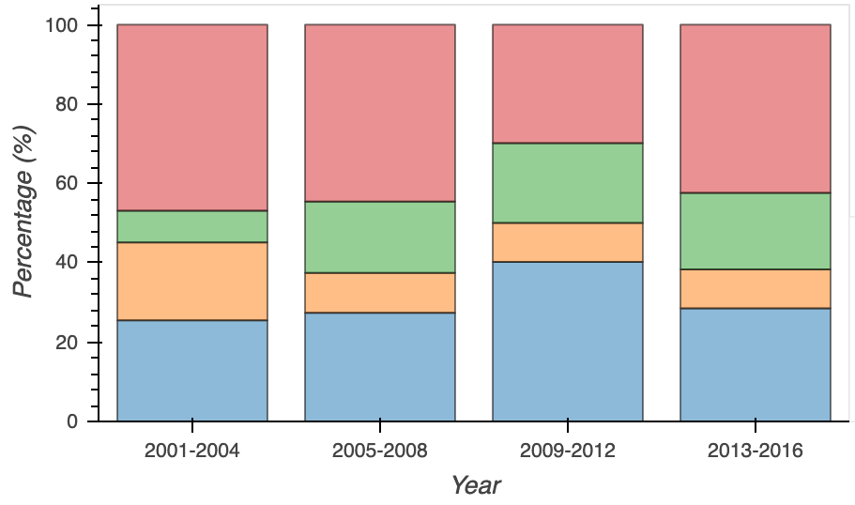
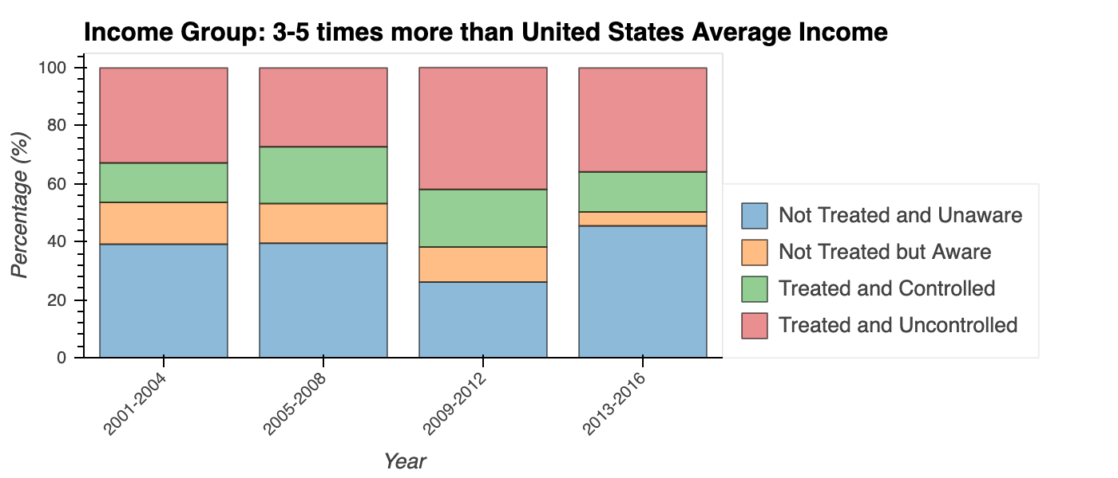
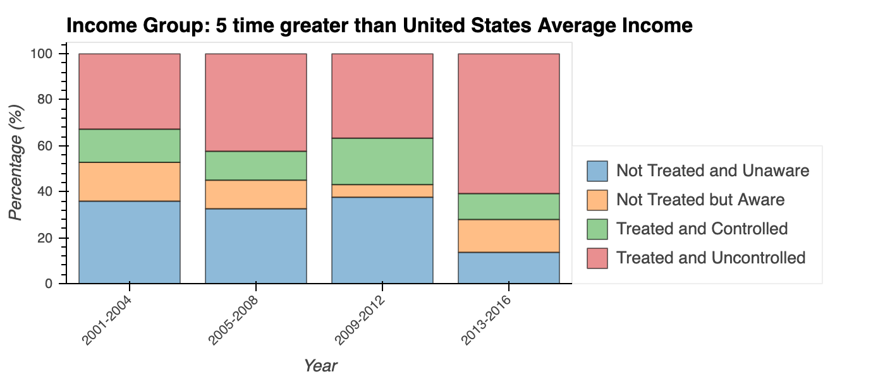
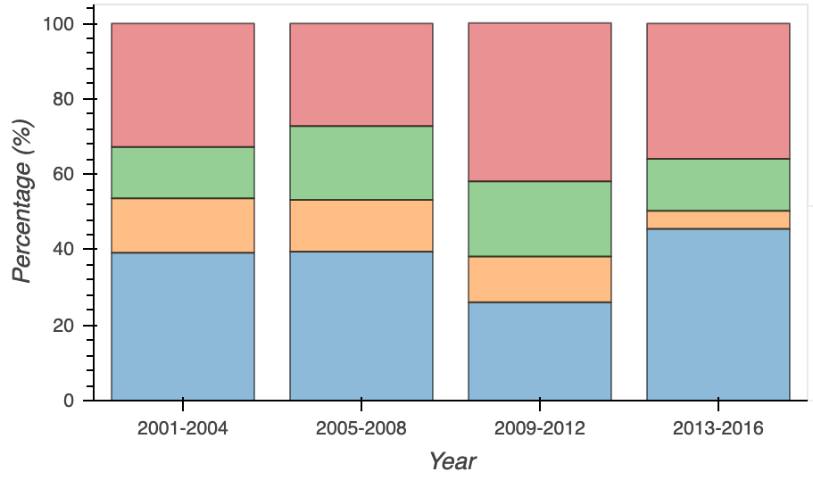
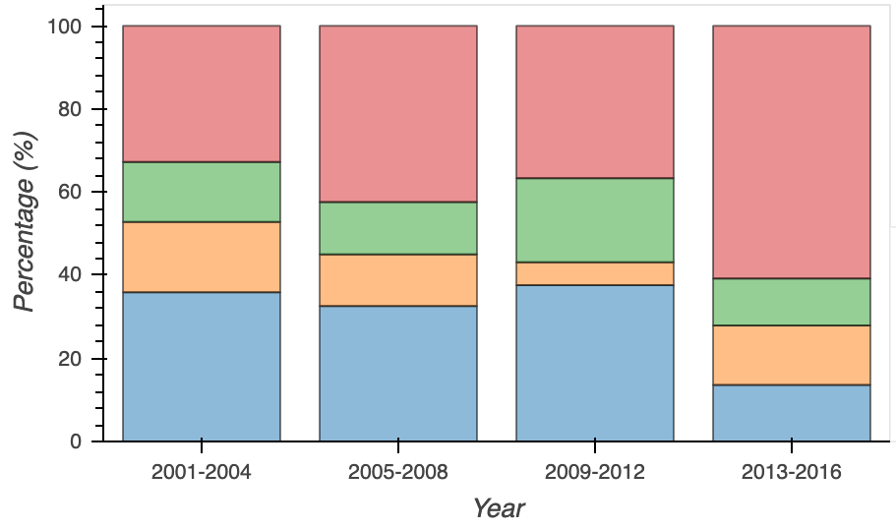
How does income affect treatment?
Notes:
Here we have the percentage of people whose diabetes are known, treated, and controlled across different income groups from lower than avg income to 5 times greater than avg income. Although there is a lot of data, we can look at sections such as the red and green, which are the people being treated for diabetes, and see that is it consistent throughout all income groups. This might be a testament to the effectiveness of low income health insurance programs such as Medicaid. You could also look at the consistent percentage of people who are unaware of their diabetes, and argue that this is due to the fact that diabetes is a disease that is very difficult to detect on your own.
Looking at the two income extremes now, we can see that from around 2003 to 2007 there was an increase in the percent of low income earners who had their diabetes being treated and controlled. This may be due to a government policy that increased access to diabetes treatment for low income earners, for example. Another trend was that in recent years, there was a large discrepancy in treatment between low and high income earners, which might indicate an increase in the rise of medical costs within the past 6 years.
Here we have the percentages of people with varying levels of awareness, treatment, and control for low, medium, high, and very high income groups in the united states. Although it’s a lot of data to look at, we can draw many different conclusions from it. For example, although you might expect higher income earners to have higher percentage of diabetics being treated, you can see by the size of red and green sections that this is not the case; this might be a good indicator that programs such as Medicaid are effective for giving low income earners access to healthcare..
Also, we can see that amongst all income groups and all years, the % of people who were not treated and unaware, the section in blue, stayed pretty constant. This may be because that diabetes is hard to detect on your own.
THEN: Fade out middle incomes
THEN: Put square around sections
THEN: If you focus on the highlighted region, you can see that low income earners had a very large increase in the number who had their diabetes treated and controlled between around 2004 to 2008. This may be due to an increased access to diabetes testing and care.
In recent years, there was a larger discrepancies between the low and high income groups in the % who received treatment in general, which might indicate recent increases in medical expenses

Slide 16
Conclusion
Diabetes has a very large correlation with obesity/BMI
These metrics can serve as an effective predictor of diabetes
Across income groups, there is variation in what percentage of diabetics are diagnosed and treated
Spikes or dips in certain income groups at certain times may be caused by government policies that increase access to diabetes testing, for example
Although diabetes has no cure, it can often be prevented by making lifestyle changes
Notes:
In conclusion, we found a high correlation between diabetes and metrics such as obesity and BMI, and these can serve as reliable metrics for prediction
We also were surprised at how various income groups were able to treat and control their diabetes

Slide 17
Sources
https://www.cdc.gov/nchs/nhis/nhis_2017_data_release.htm
https://www.cdc.gov/diabetes/statistics/slides/long_term_trends.pdf
https://www.medicalnewstoday.com/articles/318472.php
https://catalog.data.gov/dataset?tags=diabetes
https://mchb.hrsa.gov/whusa13/health-status/health-indicators/p/diabetes.html
https://data.world/health/diabetes-prevalence/workspace/file?filename=rows.csv
https://letsgethealthy.ca.gov/goals/living-well/decreasing-diabetes-prevalence/#_data-snapshot
https://towardsdatascience.com/machine-learning-for-diabetes-562dd7df4d42
https://www.who.int/diabetes/country-profiles/en/
https://data.worldbank.org/indicator/sh.sta.diab.zs
http://publichealthintelligence.org/content/prevalence-diabetes-world-2013
https://healthmetrics.heart.org/prevalence-of-prediabetes-and-diabetes-in-the-united-states-1999-2016-stacked-bar-graph/
http://ncdrisc.org/multiple-factors.html
https://healthmetrics.heart.org/prevalence-of-prediabetes-and-diabetes-in-the-united-states-1999-2016-stacked-bar-graph/

Slide 18
Thank you!
Much appreciation to Professor Jose Unpingco, Ambareesh Jayakumari, Erik Seetao, and UCSD ECE department!

